Slide 1
AvePoint Heuristic and Human Centered design Evaluation
Product Designer: Osita Nwankwo
Product Manager: Rima Reyes

Slide 2
Usability error meter
High
You may notice a meter on the left side of the screen. This is the ‘usability error meter’, it tracks the priority level of error from low, moderate and high.
Moderate
Low

Slide 3
Scenario 1: Create Workspace

Slide 4
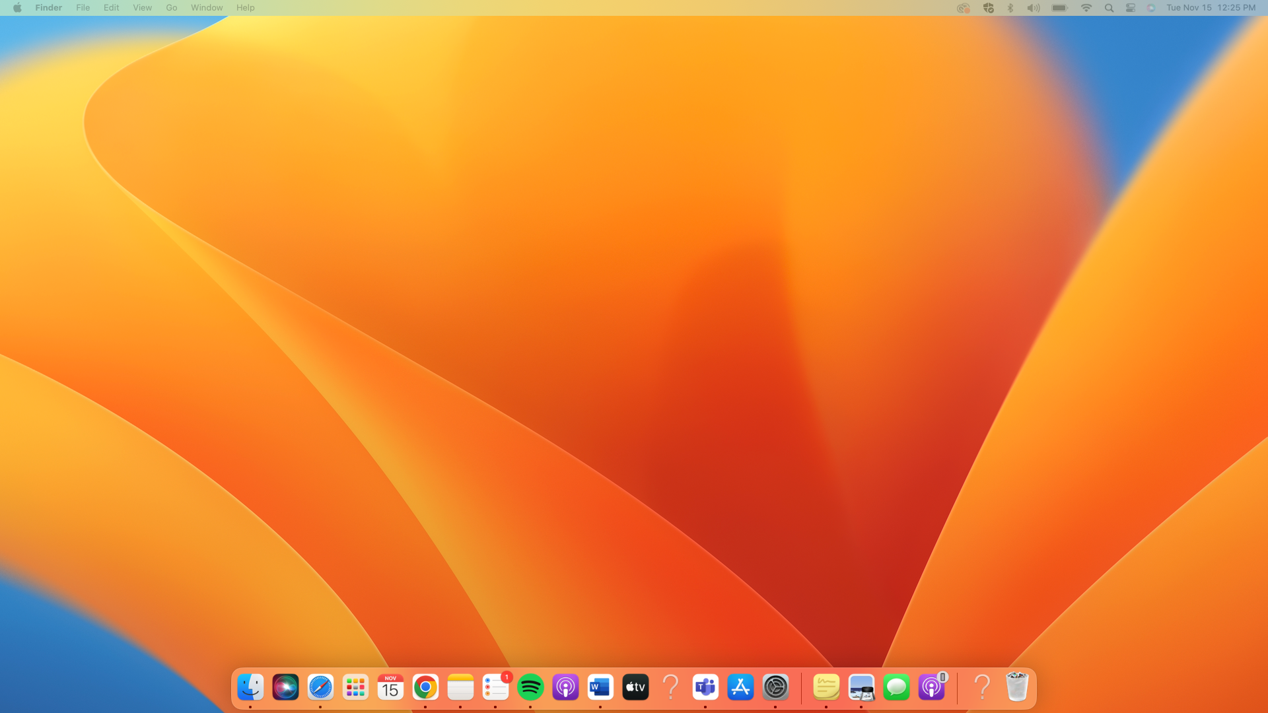
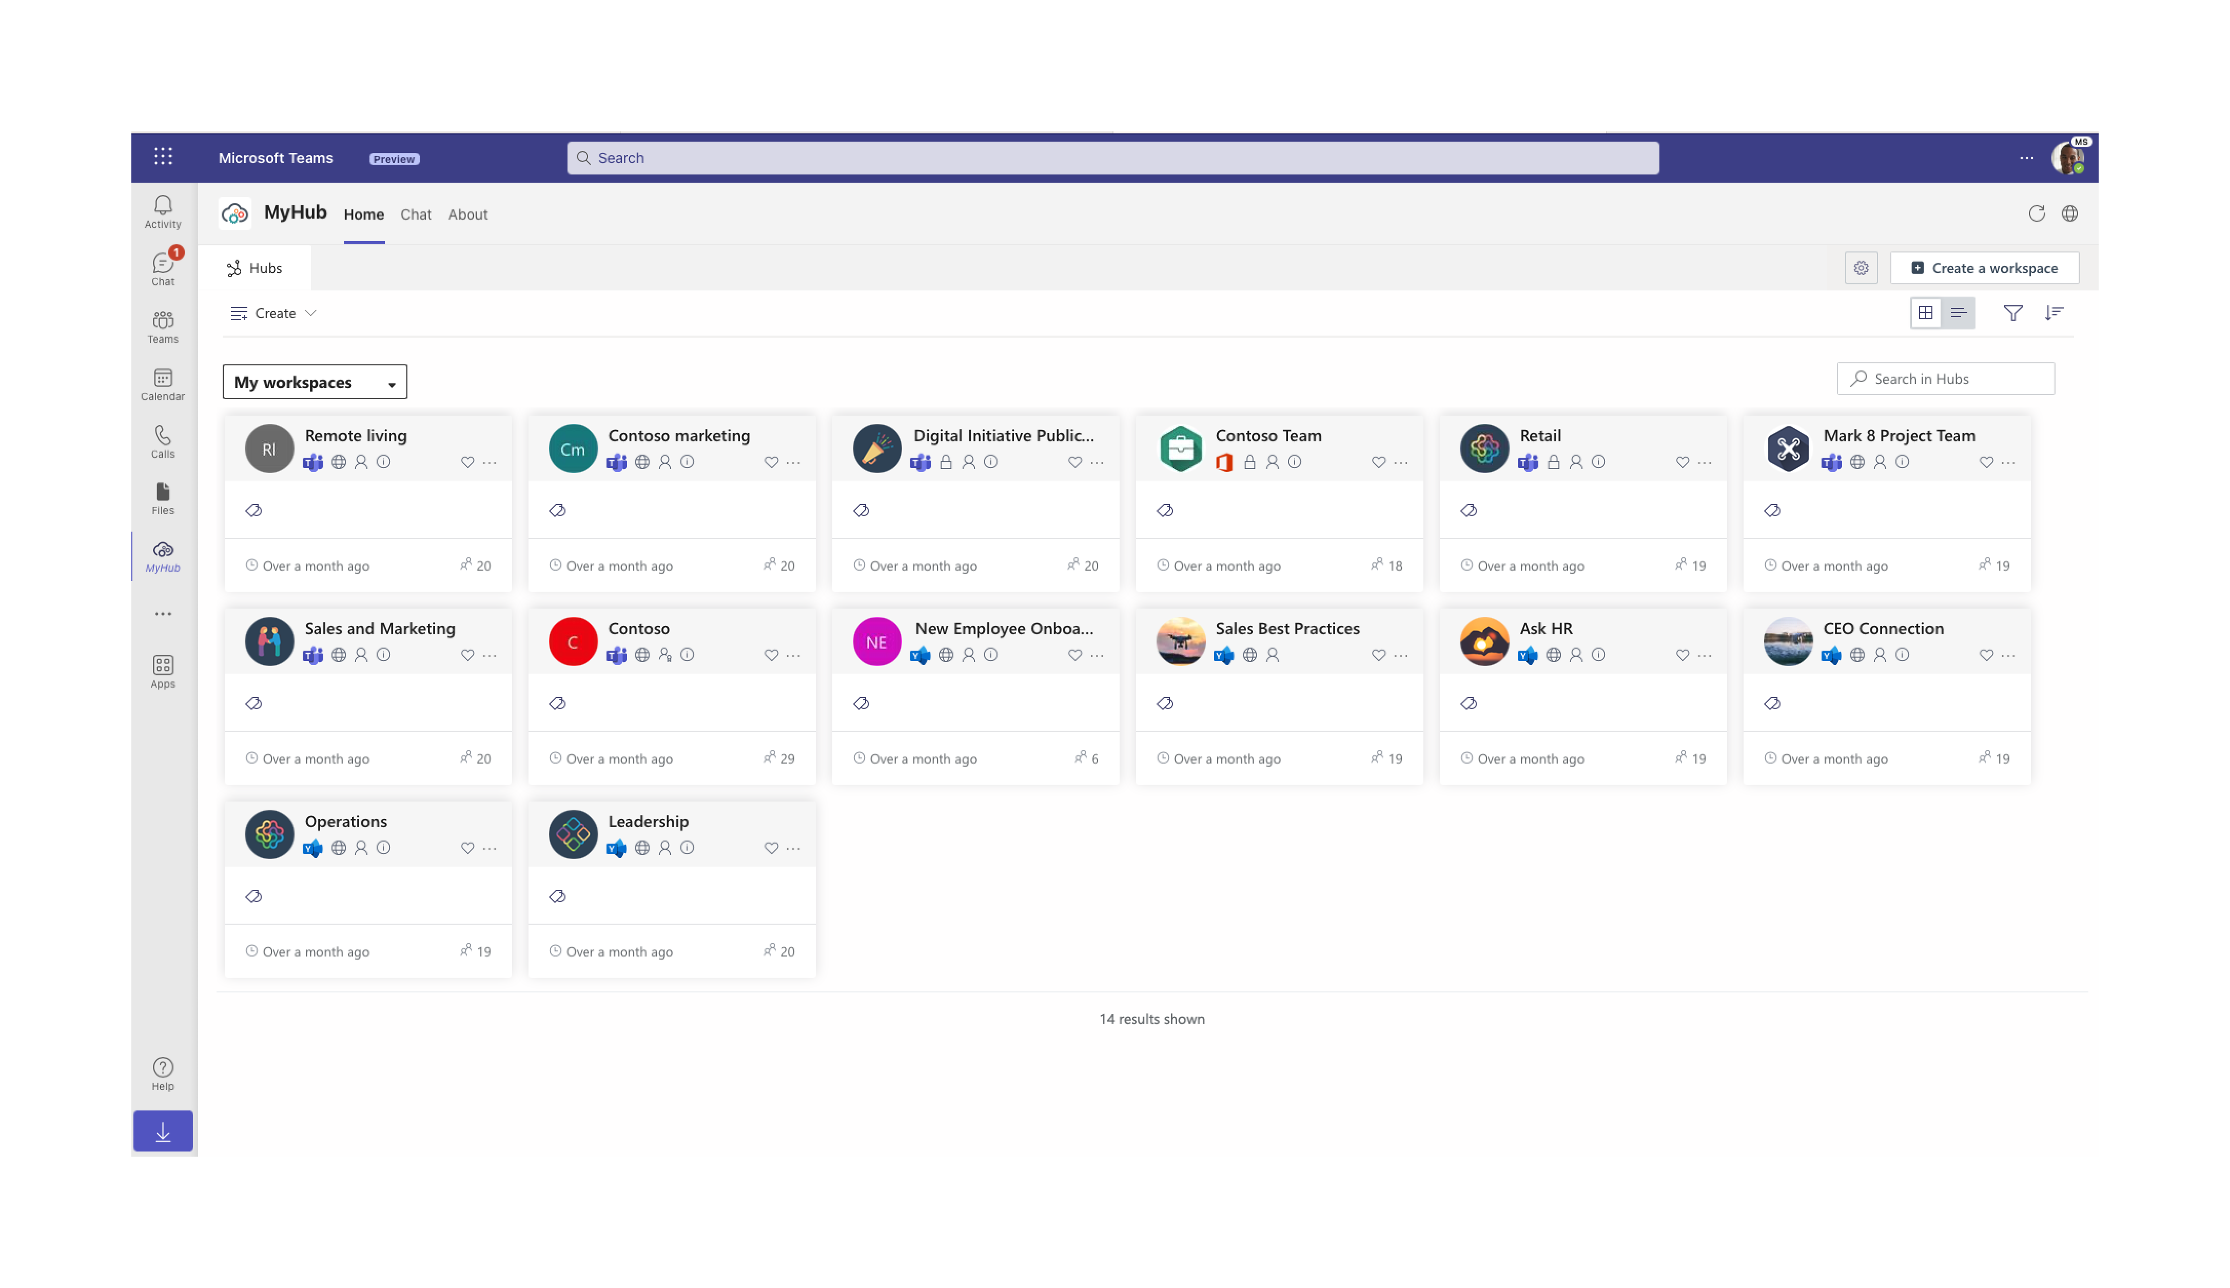
Call to action is vague
Ancillary pain
Expected gain to fix
Can increase productivity
create what?

Slide 5
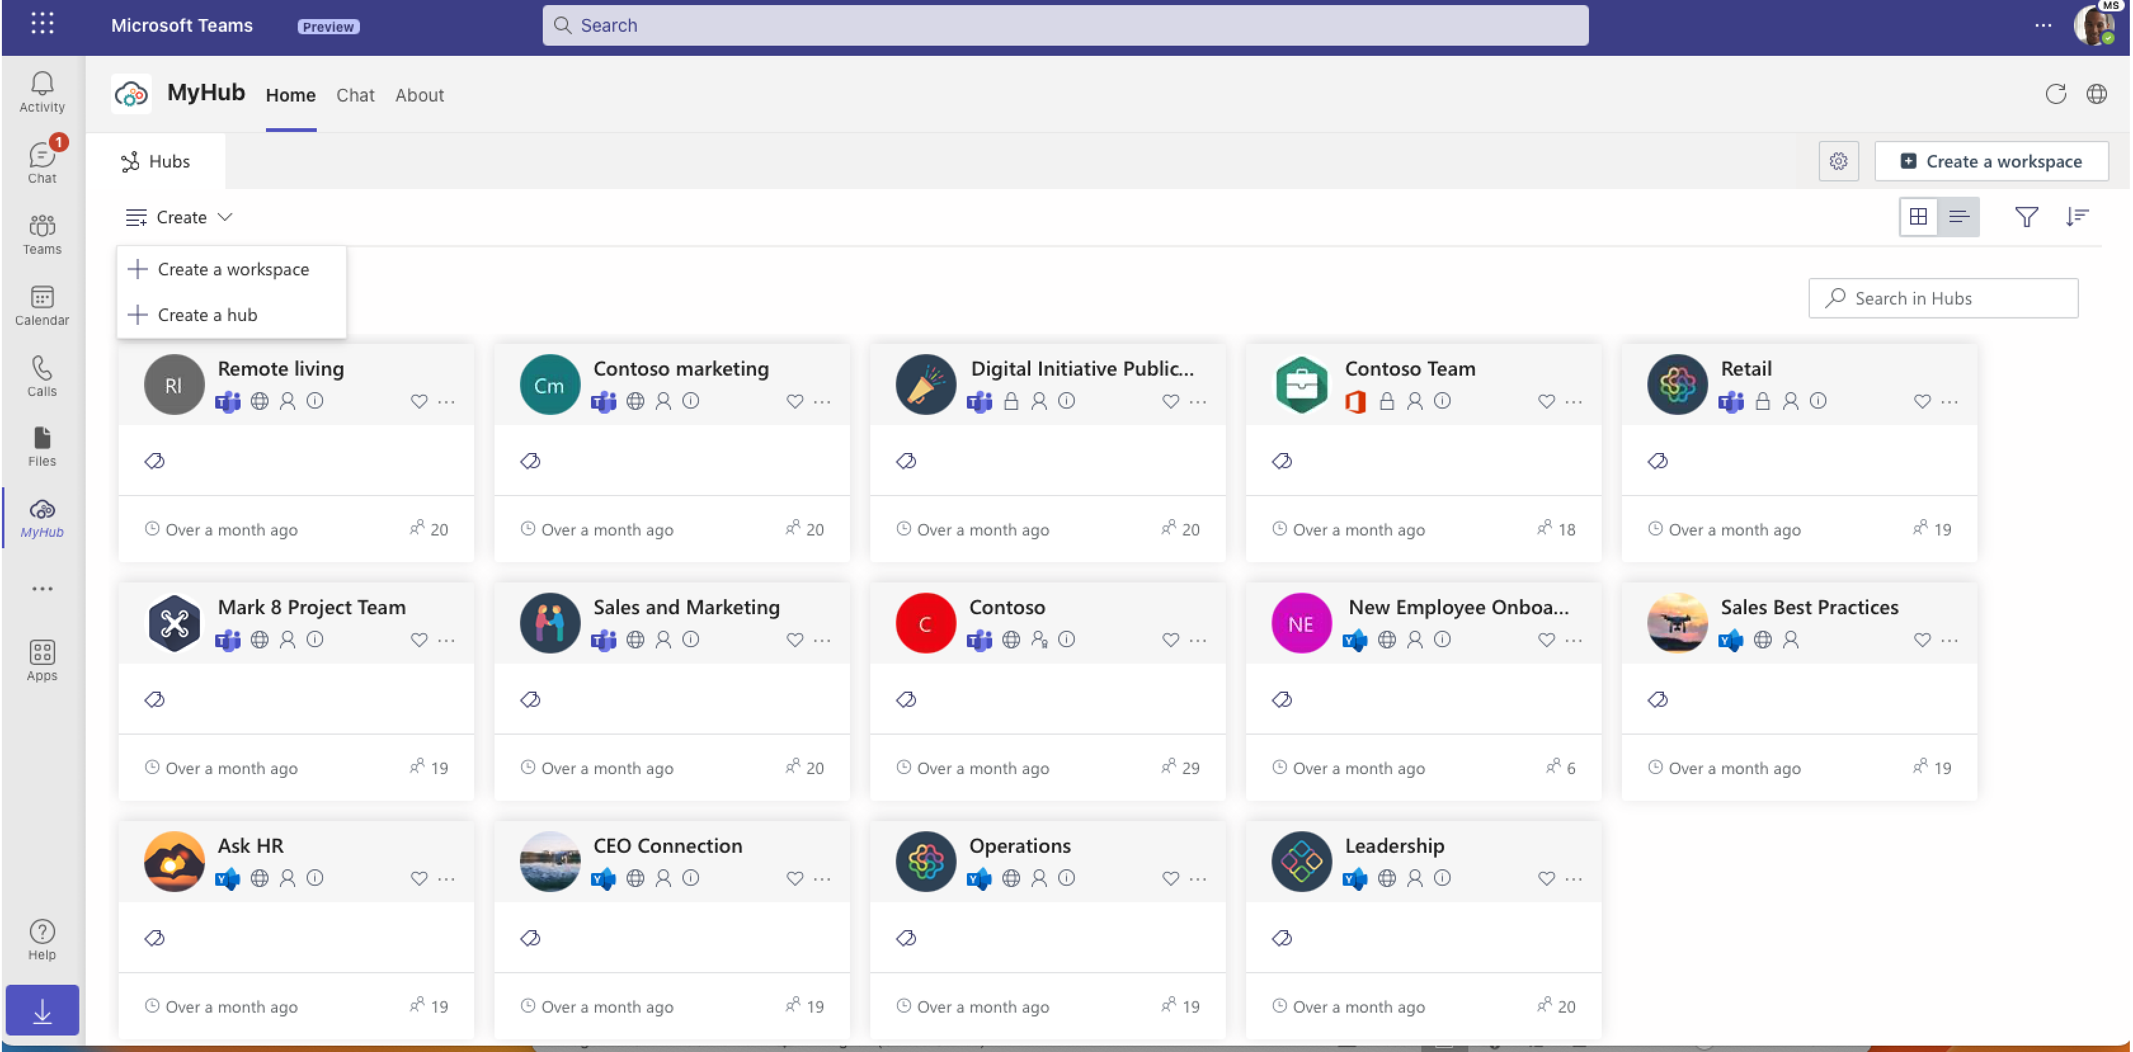
Consistency of standards issue
Leading icons are not consistant
Users should not have to wonder whether different actions mean the same thing
Ancillary pain
Expected gain to fix
Can increase productivity
Hmmm does this mean the same thing?

Slide 6
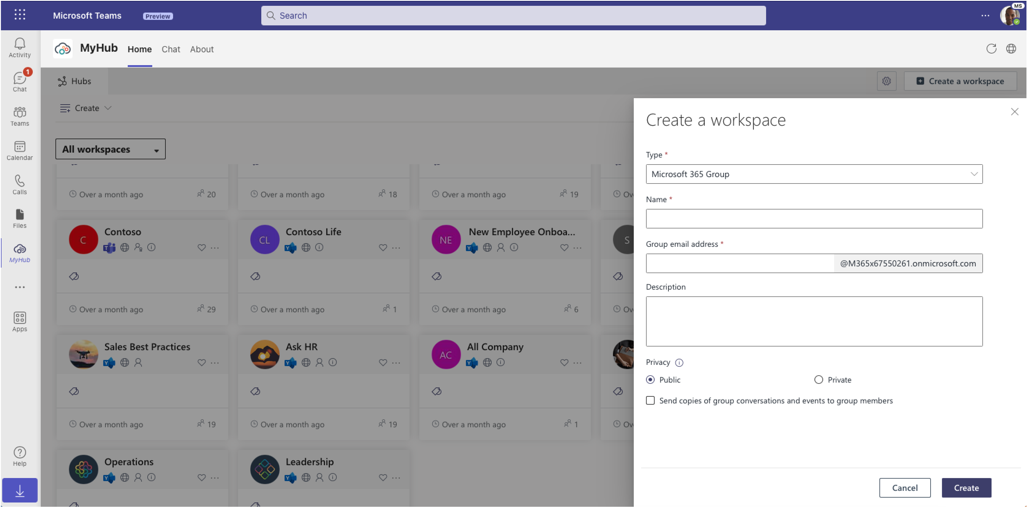
Visibility of system status issue
Keep users informed about what is going on by including sub caption
Expected gain to fix
Can increase productivity
Functional pain
what does it mean to create a workspace

Slide 7
Visibility of system status issue
No confirmation when user creates a workspace
No confirmation when I delete workspace
Create deleted section
Actions should be reversable
Required gain
Ancillary pain
Not sure if my workspace was created. Let me refresh

Slide 8
Scenario 2: Navigate through existing workspaces

Slide 9
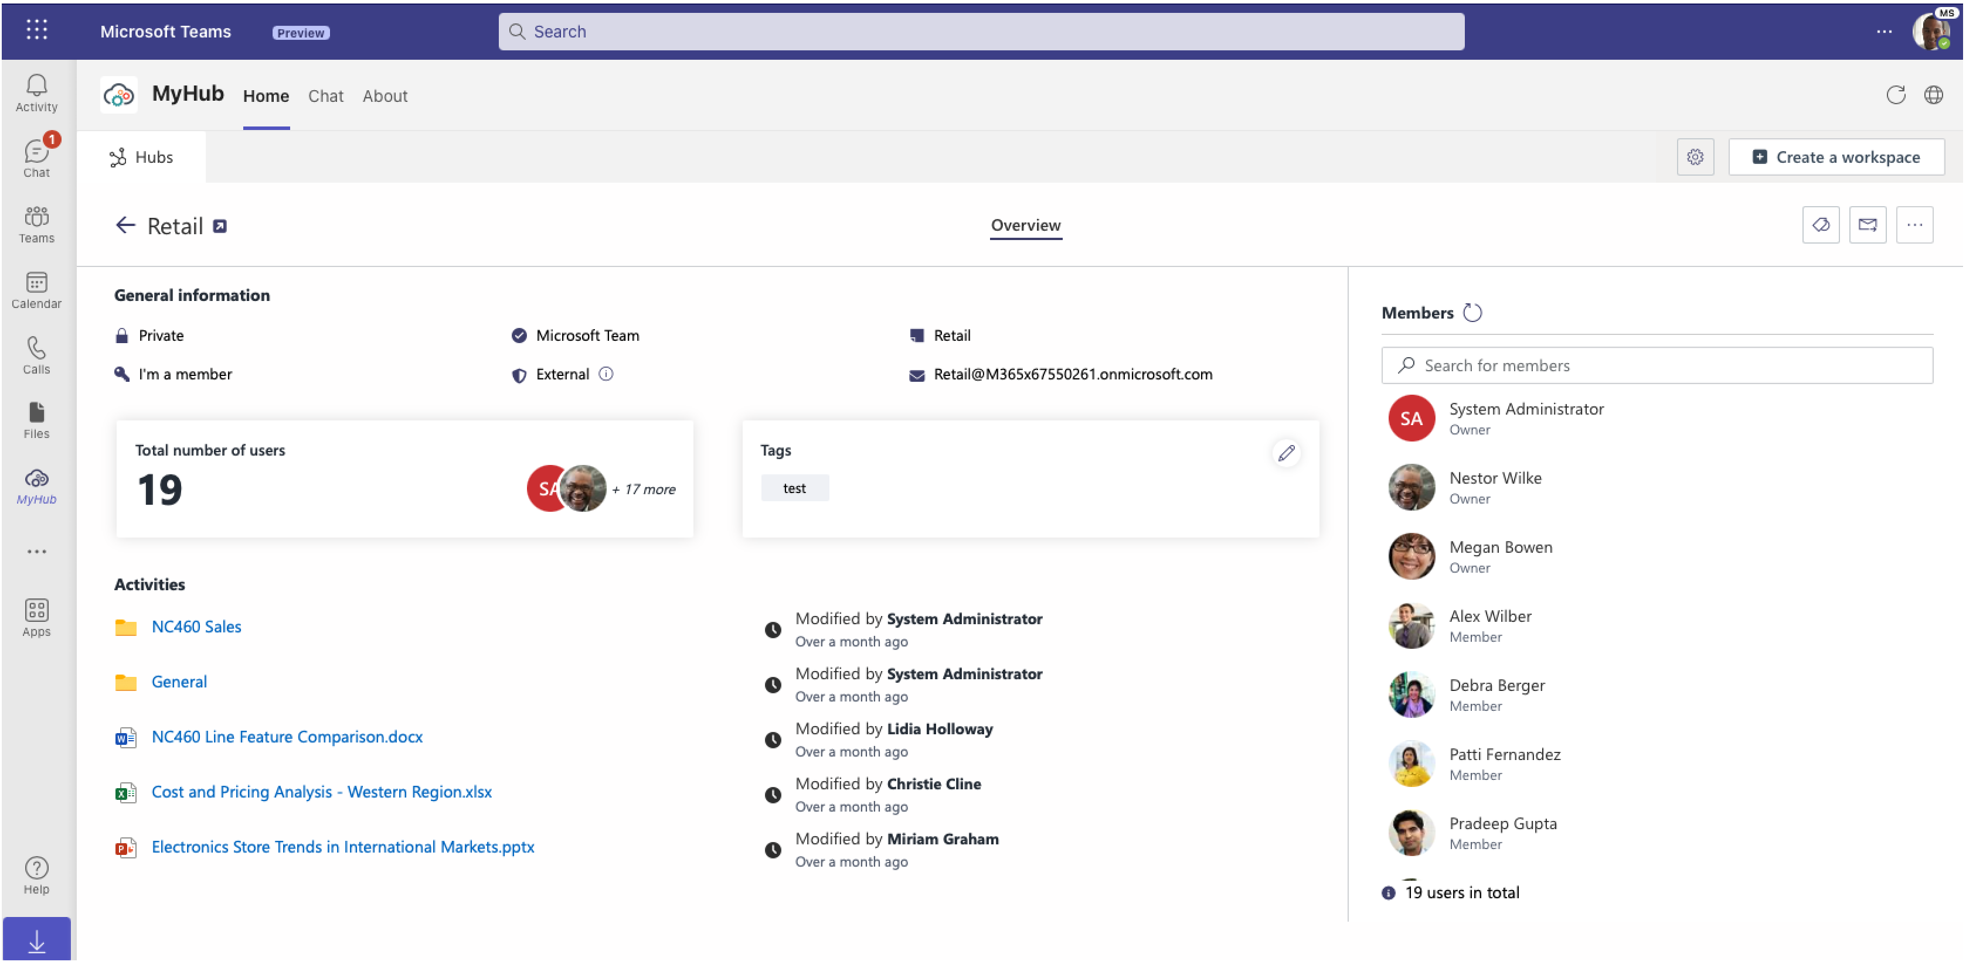
Gestalt issue
Items are visually closer and that can be perceived as part of the same group
Ancillary pain
desired gain
Can increase productivity
Hard to cypher what's what..

Slide 10
Suggestion
What if we move total number of users section to the right (members section)

Slide 11
Scenario 3: Simplified Searching

Slide 12
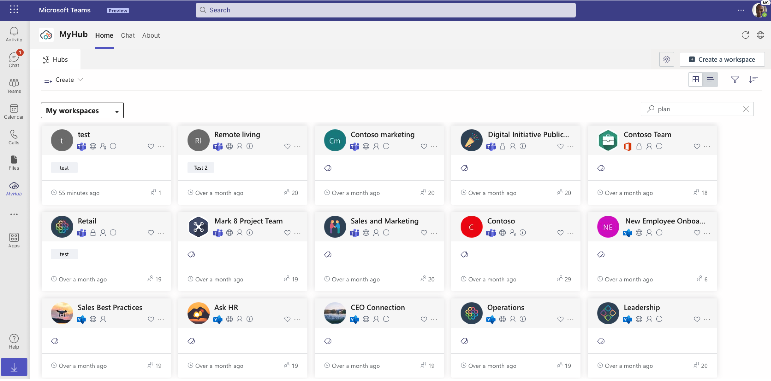
Let me search all ‘plan’ tags on this hub

Slide 13
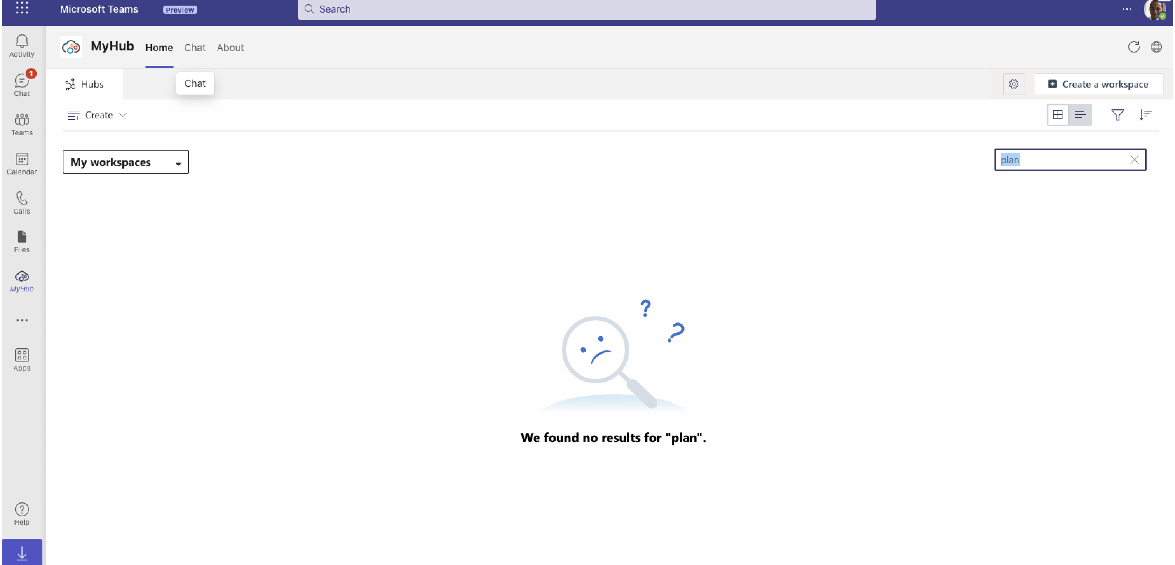
Suggestion
Consider auto fill features
Include tags in search component
Search doesn’t work for tags

Slide 14
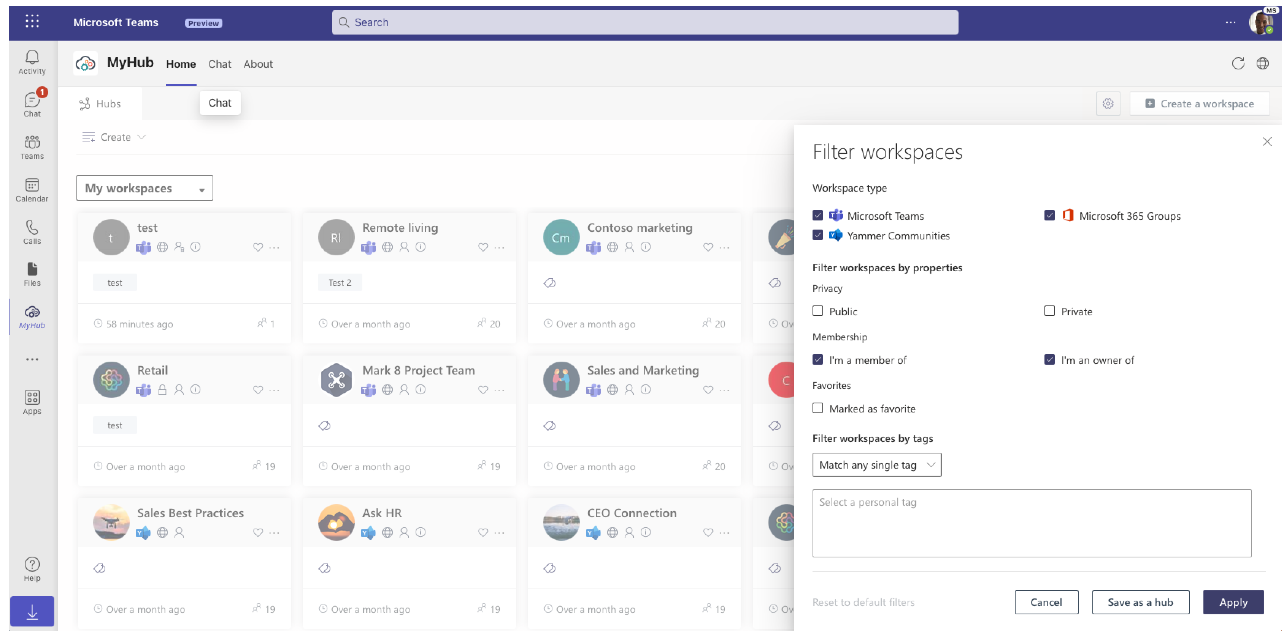
Consistency of standards issue
Titles are not size is not consistent
Inhouse consistency
This feels sloppy

Slide 15
Match between system and real world
Not a great sub-caption
Are we sure that users understand the meaning of ‘privacy’
What does that mean?

Slide 16
Scenario 4: Membership management

Slide 17
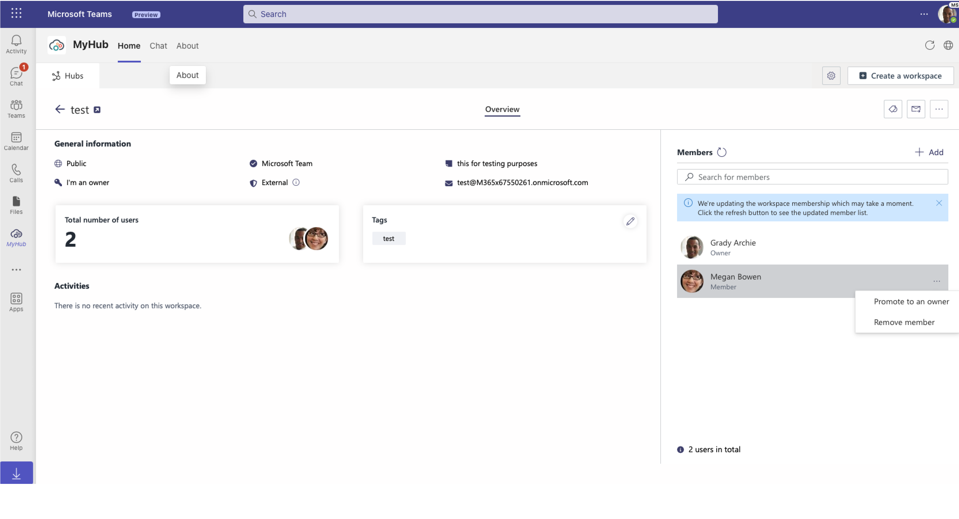
Recognition issue
Replace ellipse with icons on listing component to speed up interaction
Desired gain
Ancillary pain
Hmmm how do I remove members?

Slide 18
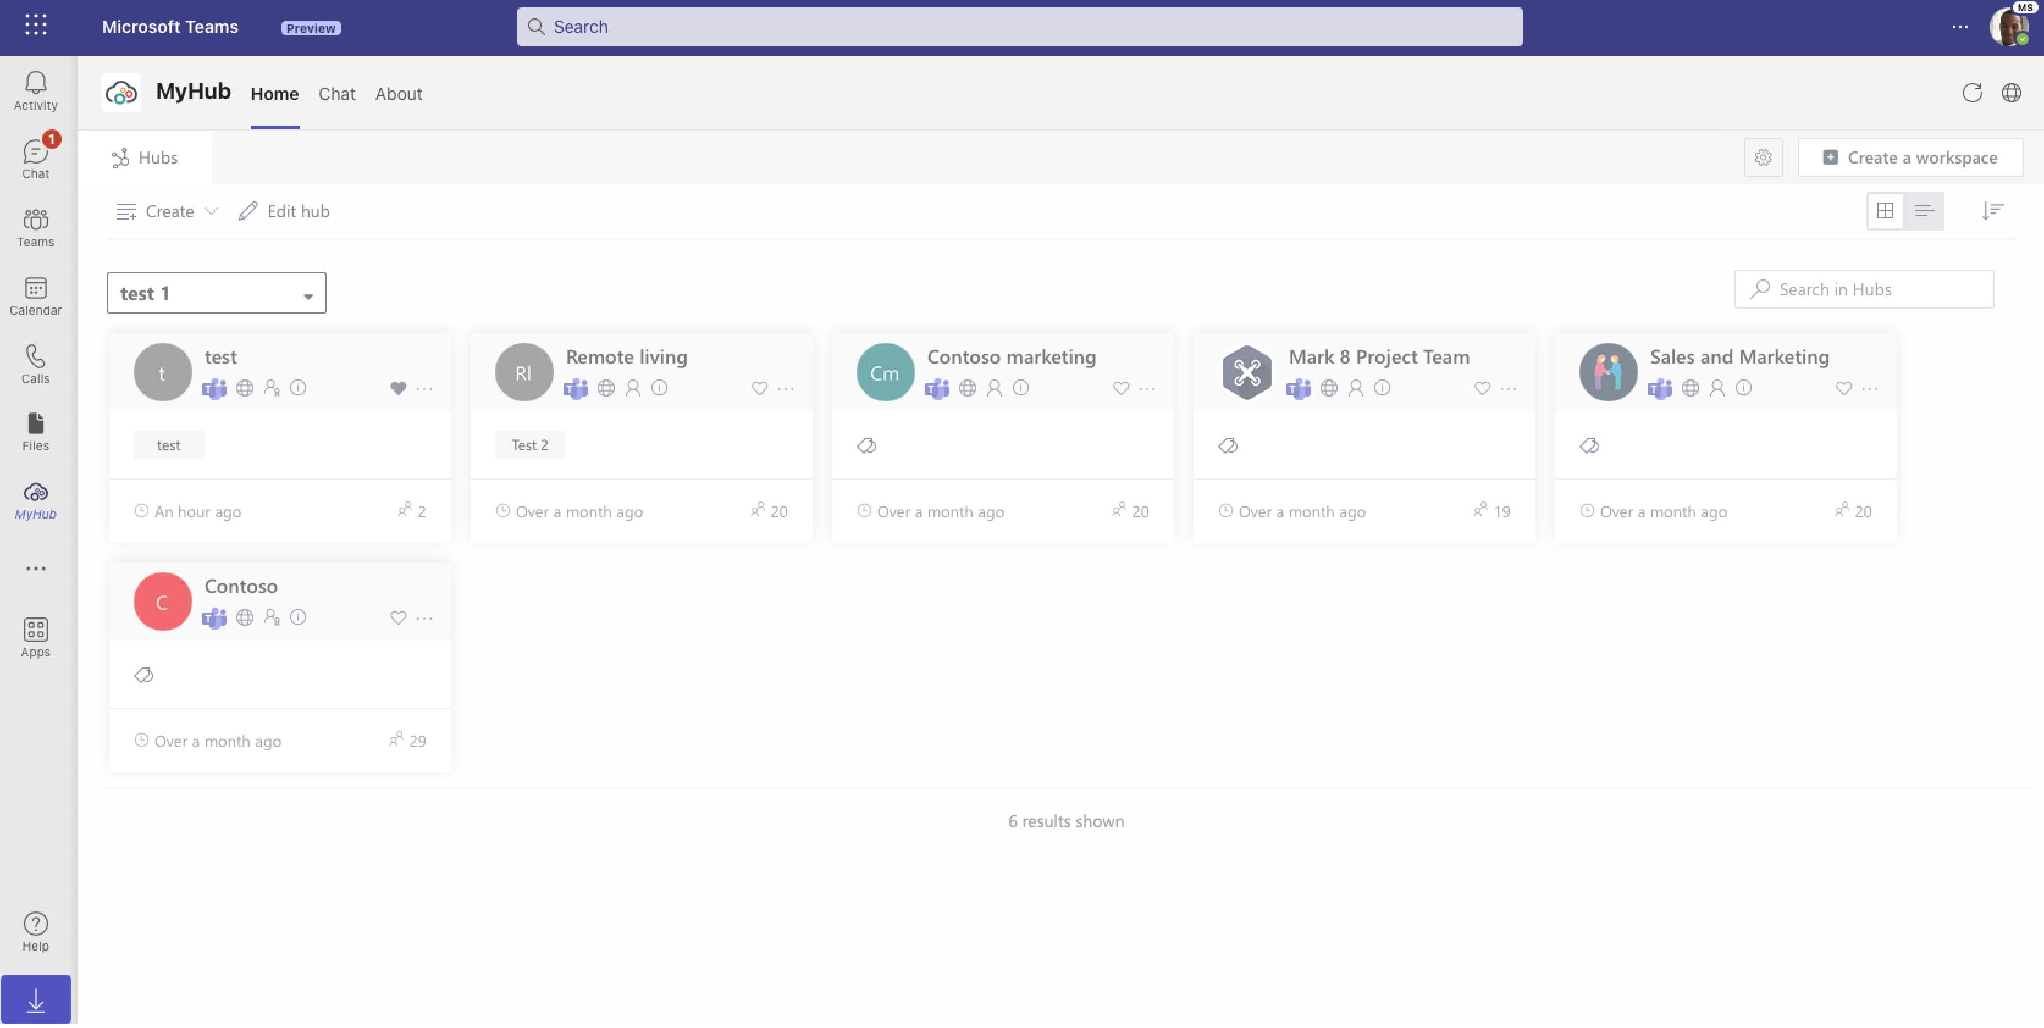
Visibility of system status issue
Glitch
Required gain
Functional pain
‘Edit hub’ must be a glitch…

Slide 19
Scenario 5: Aggregated Access

Slide 20
I wish there was an easier way to access files from workspace

Slide 21
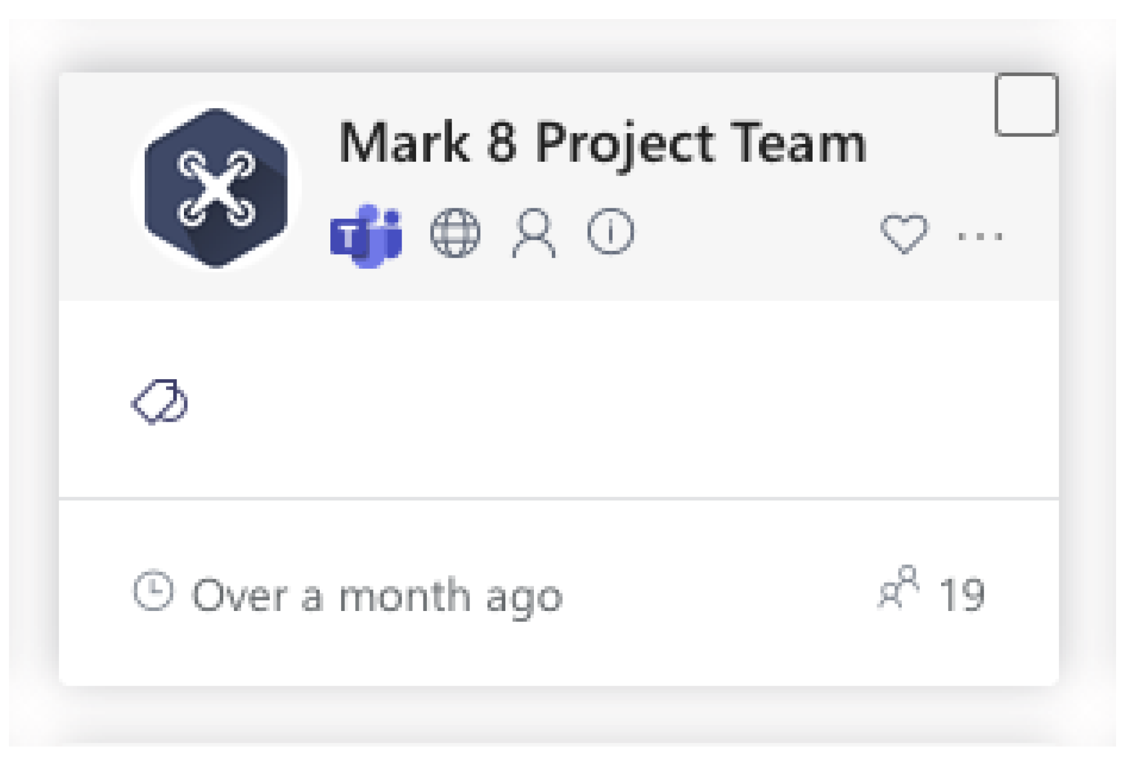
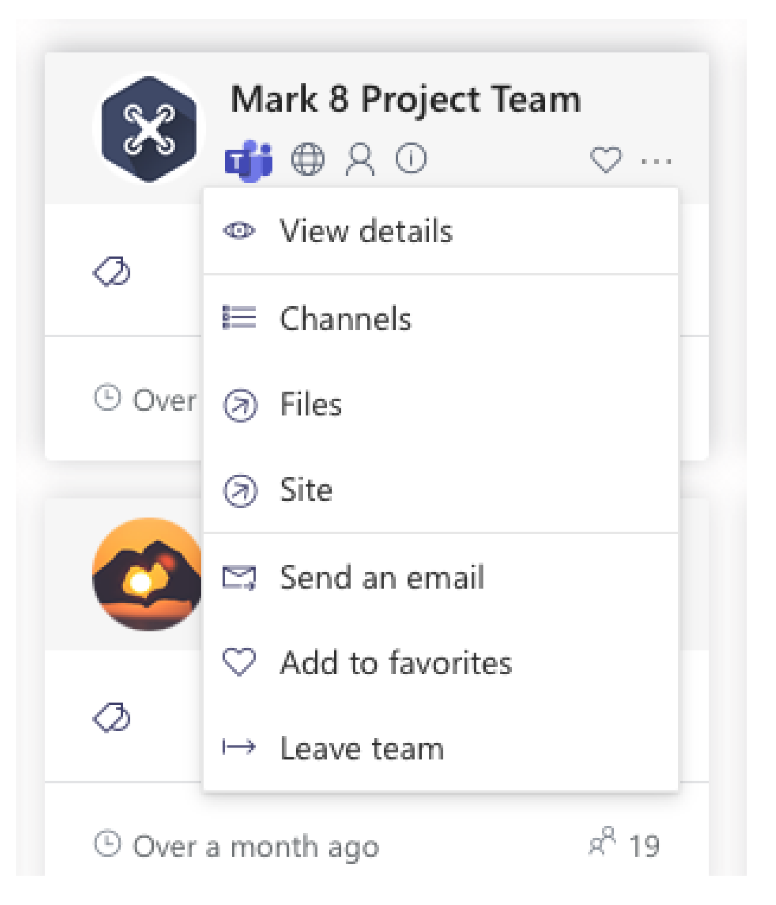
Flexibility and efficiency of use issue
Any attempt to hide complexity will serve to increase it
Desired gain
Ancillary pain
Maybe its in this menu

Slide 22
Suggestion
Include a files icon on workspace card to speed up interaction
Controls and other objects necessary for the successful use of software should be visibly accessible at all times.

Slide 23
Scenario 6: Help Documentation

Slide 24
No help documentation
Its best if the design doesn’t need any additional explanation. However, it maybe necessary to provide documentation to help users understand how to complete their task
Required gain
Functional pain
That’s it?

Slide 25
Scenario 7: List view for ‘My Workspace’

Slide 26
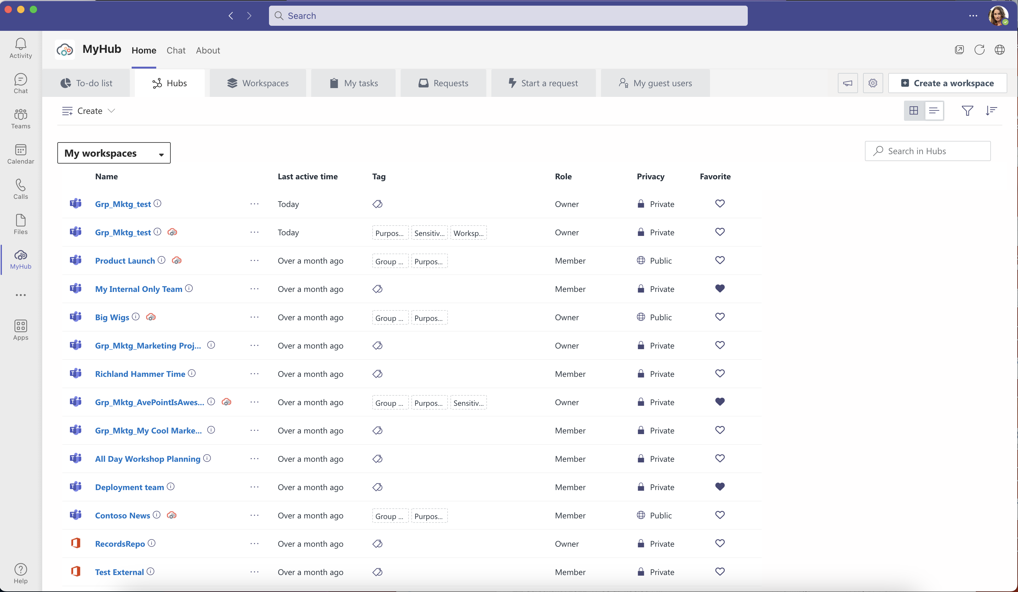
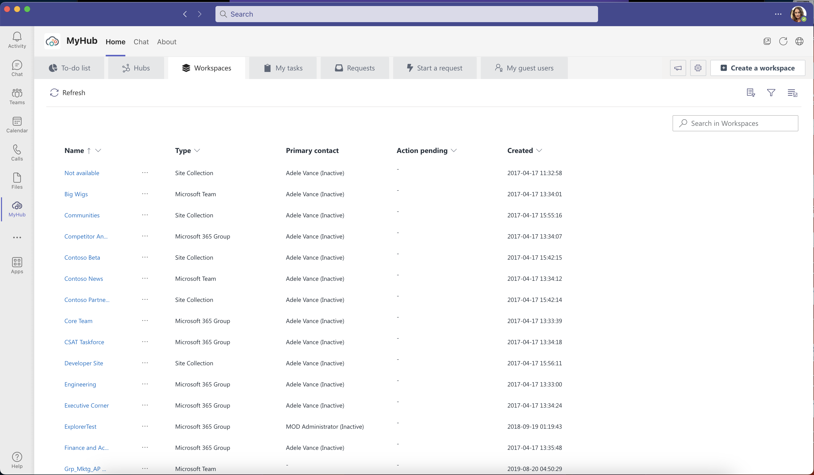
Recognition Rather than Recall
Information required to use his design should be visible
Suggestion
Label column to reduce cognitive effort
Add a go to icon for users who want to go to channel from here
Consistency and standards
Improve learnability by maintaining both types of consistency: Internally
Suggestion
Community or Microsoft logo
Why isn’t this
column labeled like the rest?

Slide 27
Flexibility and efficiency of use
Provide accelerator to speed up interaction
Icons should be discoverable but not obtrude
Suggestion
Once row is selected Icons should appear on top app bar
icon appears on hover
Activity row with disabled and enabled icons
I wish there was an ‘edit’ icon to speed things up

Slide 28
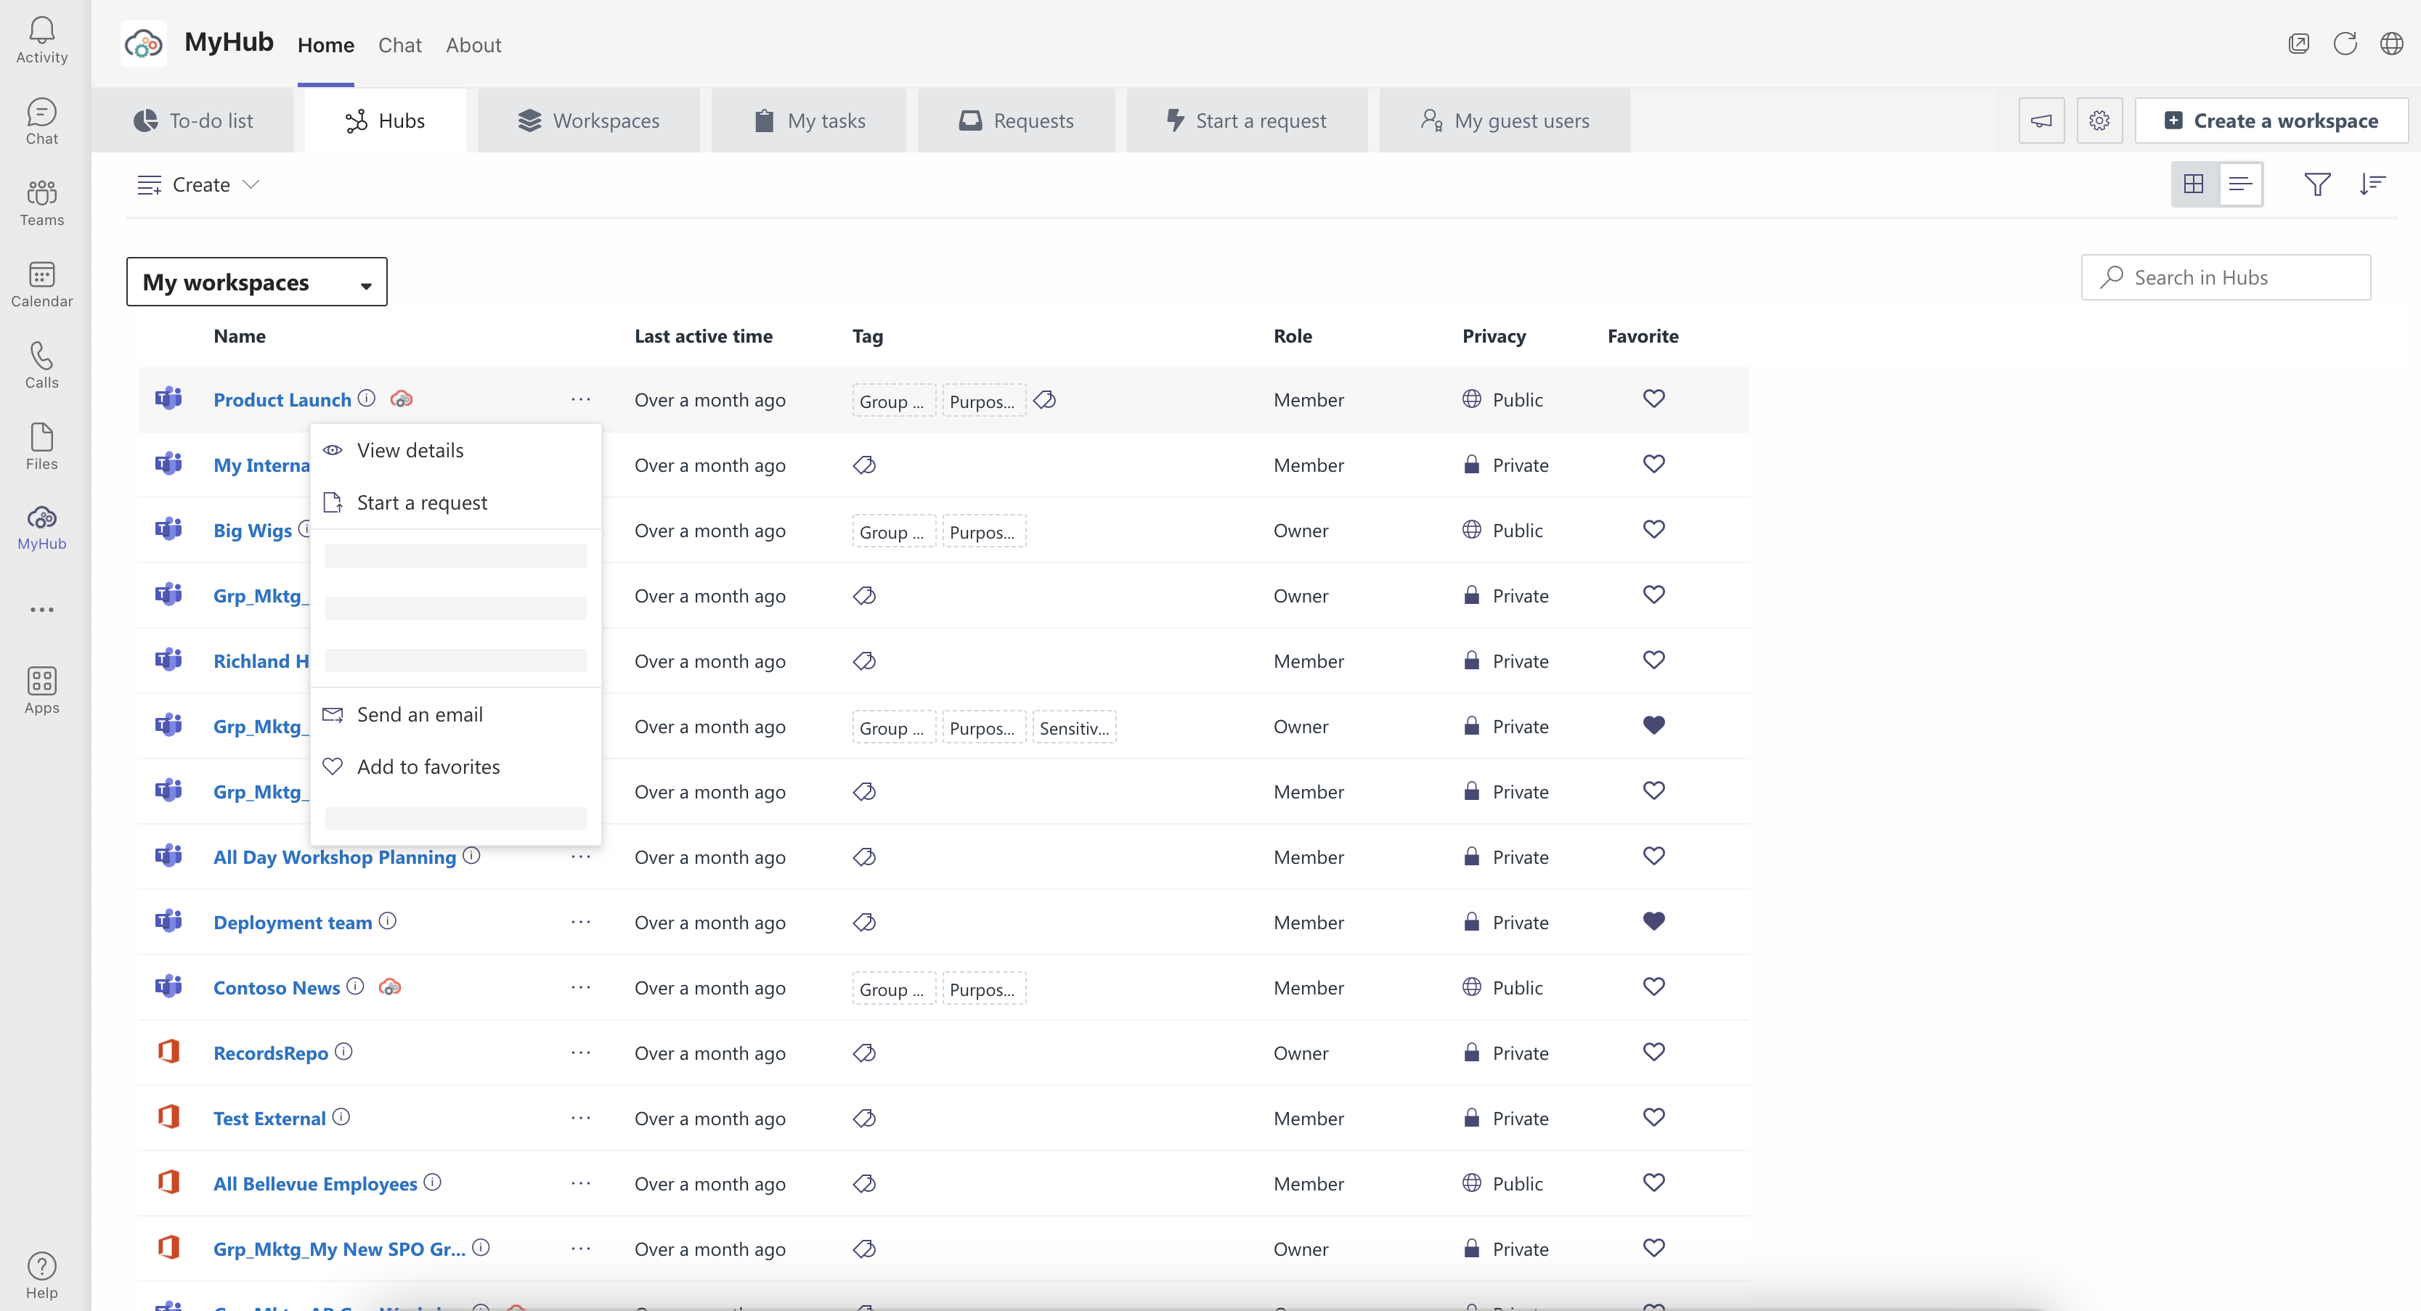
Consistency and Standards
Follow industry conventions
Suggestion
Only showcase the available options
Is this a glitch?

Slide 29
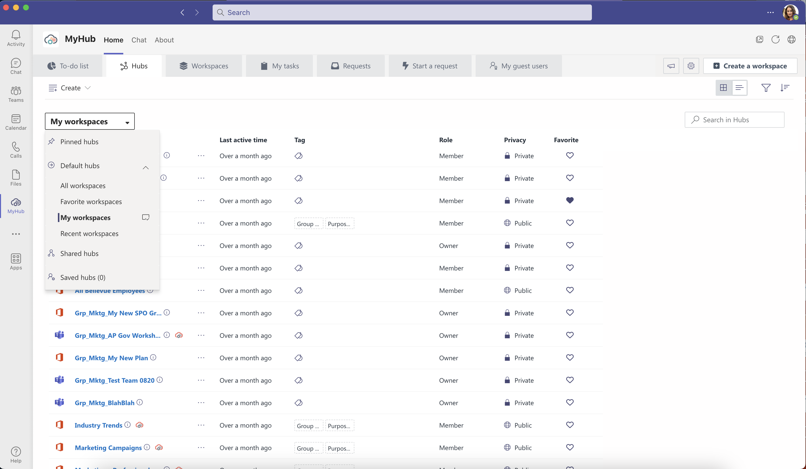
Flexibility and efficiency of use
To speed up this interaction include railing navigation with associated icons
Must be a faster way to access favorite workspaces

Slide 30
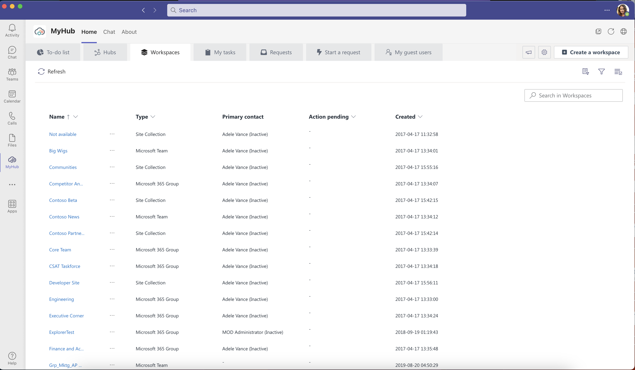
Aesthetic and minimalist design
Interfaces should not contain information which is irrelevant or rarely needed
What is the difference between workspaces and hub tab
Suggestions
You can easily include the last three columns in the hubs tan
What is the difference between workspaces in the hub tab and workspaces tab?

Slide 31
Scenario 8: Start a request

Slide 32
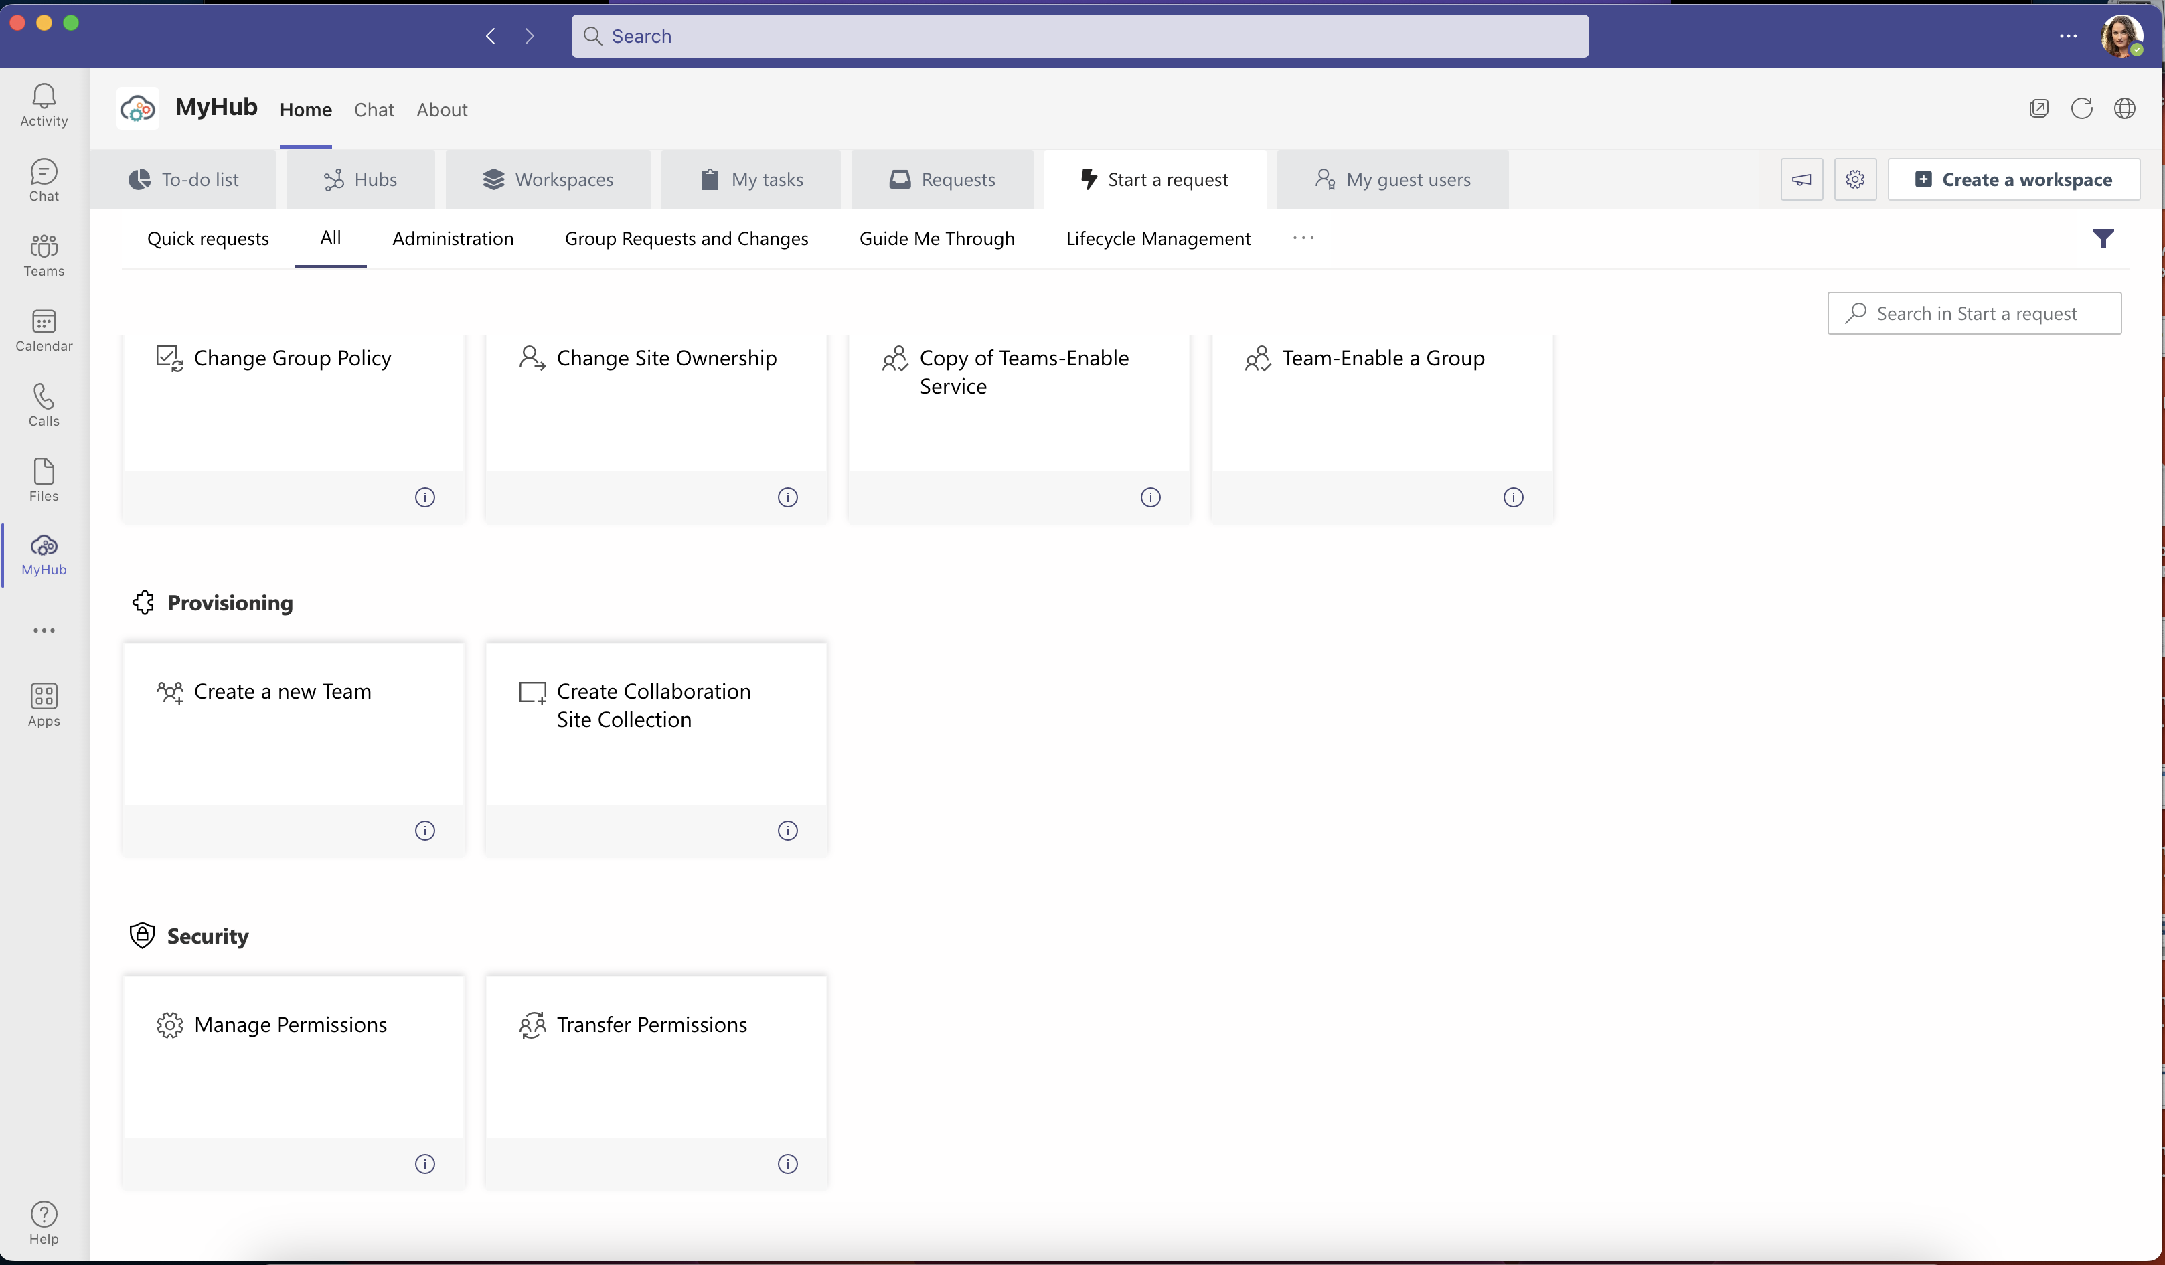
Match between and real-world systems
Are users able to understand the meaning of provisioning without having to go look up the definition
Hmmm, what do you mean by provisioning?

Slide 33
Match between system and the Real World
Defaulting users into the contact container does not seem like the logical order of things
Why did it default to these contacts?

Slide 34
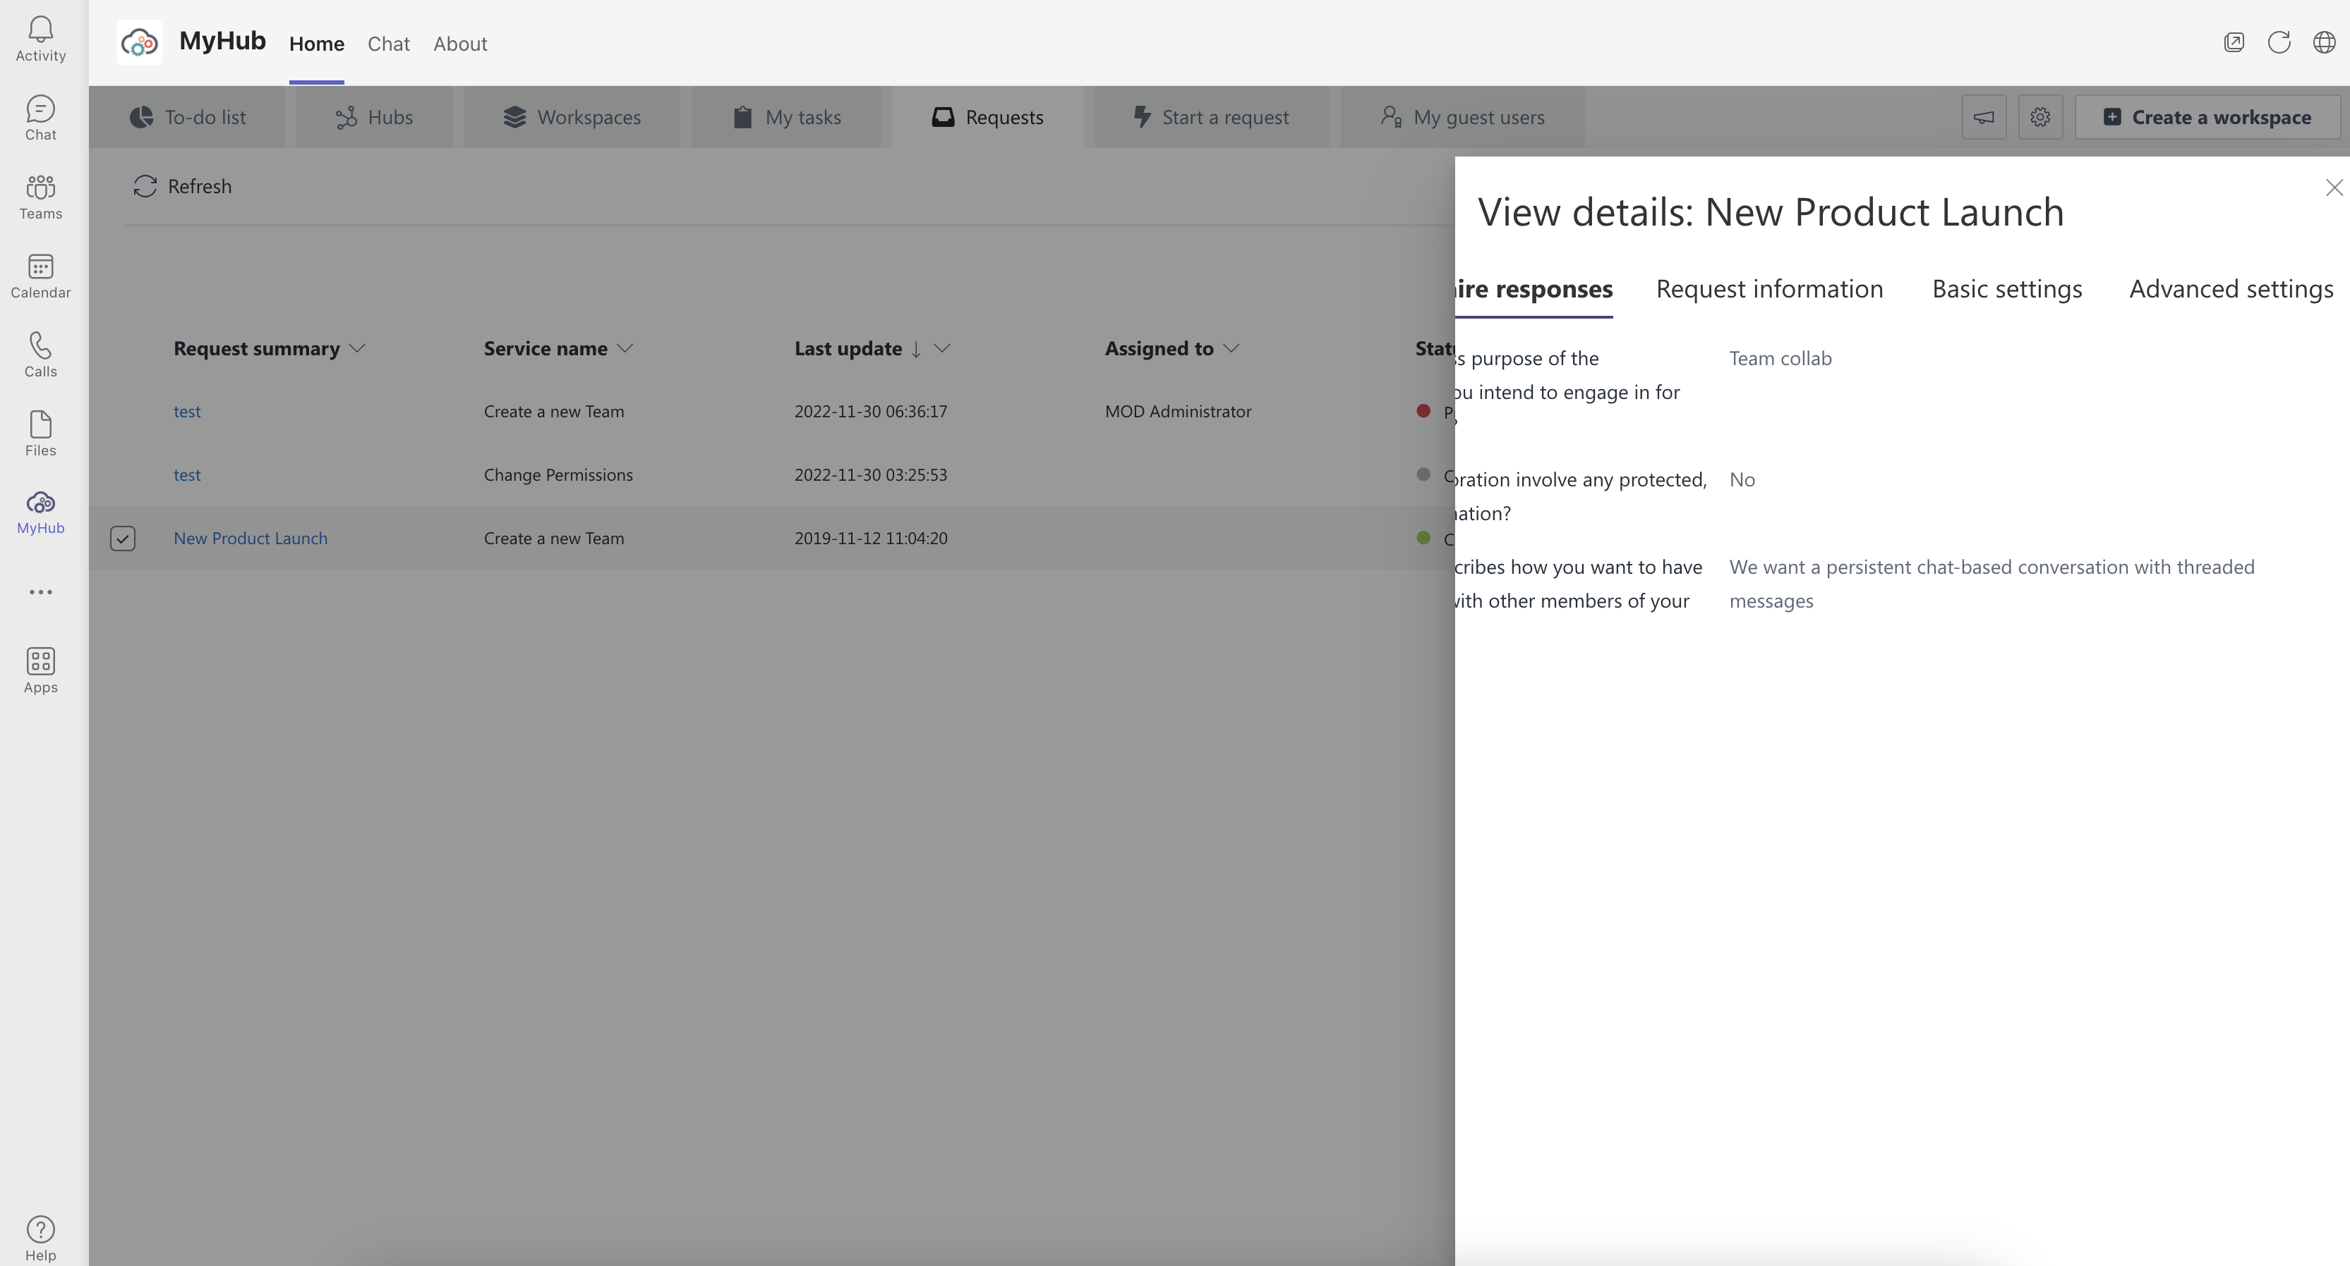
Consistency and Standards
Follow industry conventions
Suggestion
Make the navigation sticky with horizontal scroll capability
Looks like a another glitch?

Slide 35
Scenario 8: My task

Slide 36
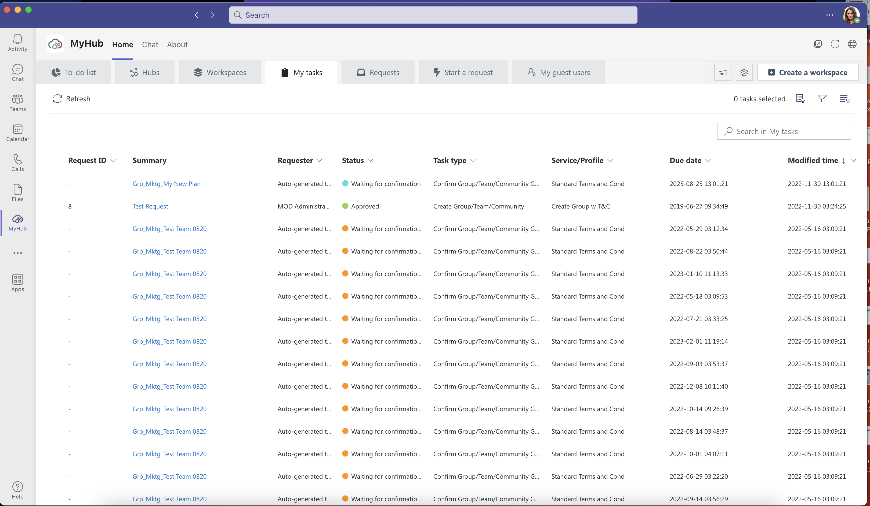
Error preventions
Eliminate error prone conditions
‘To-do list’ and ‘my task’ are very similar naming conventions and can result in confusion
I'm confused…what is the difference between ‘to-do list’ and ‘my task’ tabs

Slide 37
SAAS offer

Slide 38
Usage-based Pricing
Is the ‘start a request’ metric
Aligned with customers needs
Is growing proportionally to usage
Easy to understand
Build pricing around ‘start a request’ metric to maximize upgrades

Slide 39
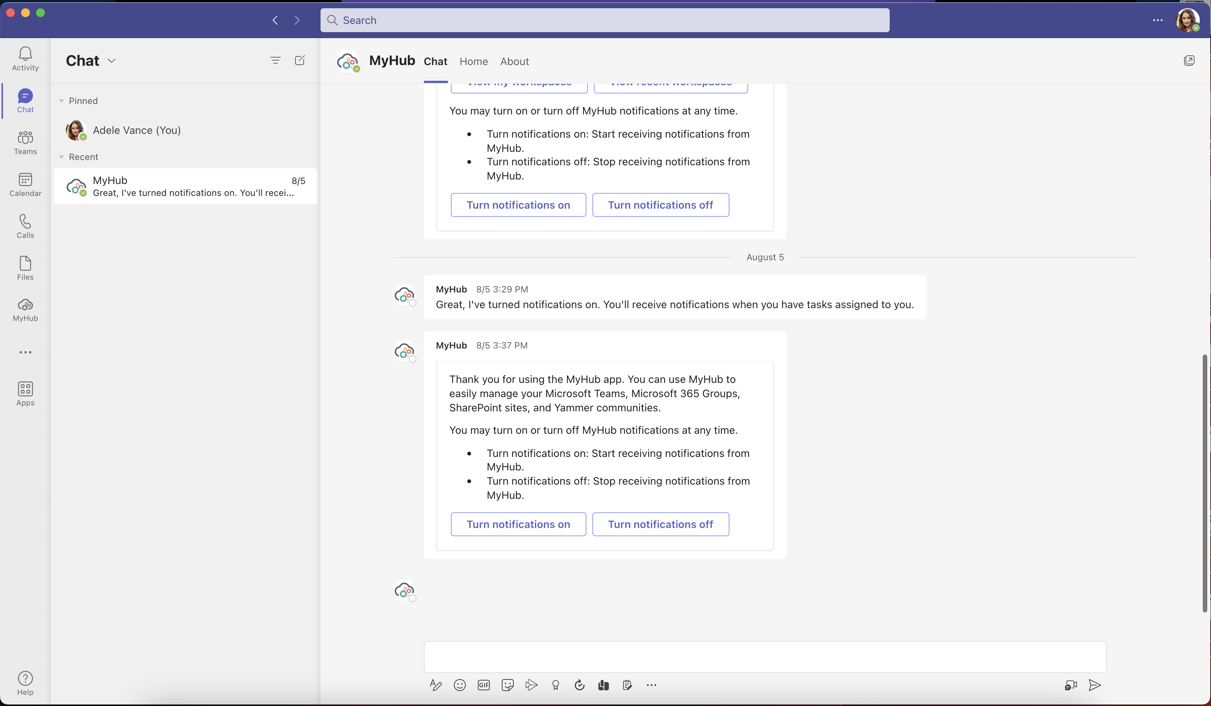
Loss Aversion
We hate losing or letting go of what we have (even if more could be had)
Using a visual anchor to reinforce loss aversion is a great way to maximize engagement rate of your users
It would be nice to send a illustration on my personal chat indicating task limit

Slide 40
Build a freemium
Make sure to keep retention high by giving real value in your free version
Treat your freemium as an acquisition tool, not a revenue tool
Make sure your free product matches the intent of your premium offer to maximize conversions
On Second thought… find out why current premium members pay for your services and reverse engineer their desires

Slide 41
The power of Micro Trails
When you ask a user to switch from freemium to premium, make it easy to experience the value he/she will be getting if they pay. Like giving a free trial except for a specific feature
On Second thought… find out why current premium members pay for your services and reverse engineer their desires

Slide 42
Progressive Disclosure
It consist of showing a few features initially like hub tab and then slowly add more tabs as users become better
Its very powerful because it keeps simplicity for new users and brings power to advanced users
Another strategy would be to show only a few features initially and slowly add more.

Slide 43
Curiosity Gap
Gaps cause pain
When we want to know something but cant, its like having an itch that we need to scratch
To take away the pain, we need to fill the knowledge gap
As engagement increases then make your offer

Slide 44
The End

